Slide 1
National Association of District Export Councils
Working for America’s Exporters

Slide 2
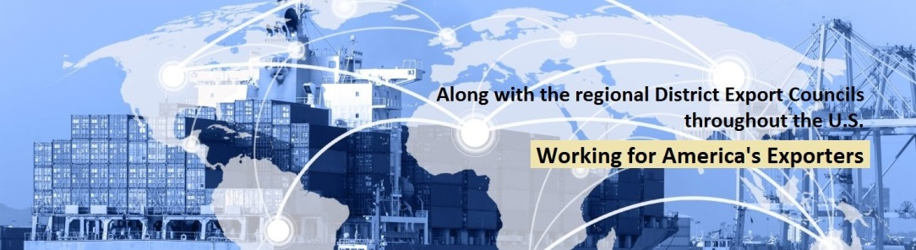
What is NADEC?
Association of regional District Export Councils throughout the U.S.
NADEC increases awareness and understanding of the importance of exports to the US economy through education, legislative outreach and engagement with DECs and other relevant stakeholders

Slide 3
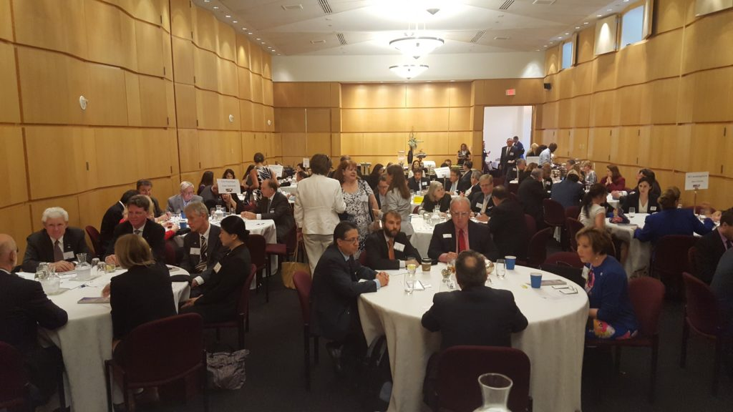
Who is NADEC?
District Export Councils are organizations of business leaders from local communities, whose expertise in international business provides a source of professional advice for their region’s local firms
Over 60 DECs throughout the country
Approximately 1,500 DEC members
NADEC 2018 Legislative Summit in Washington D.C.
Over 90 DEC members, Department of Commerce officers, and industry representatives attended

Slide 4
NADEC’s Goals
Counsel and mentor local businesses in exporting
Identify export financing sources for businesses
Create greater export awareness in the business community locally
Identify issues affecting export trade and implementation of suggestions for improvement
Advocate trade policy and legislation supporting exporters and the U.S. export sector
Support programs and services of the U.S. Export Assistance Centers
Build local export assistance partnerships with other trade-related organizations
Provide export training and education through Export University® programs

Slide 5
International Trade
More than 41 million American jobs depend on trade, and trade is critical to the success of many sectors of the economy.
In 2014, 60% of imported products to the U.S. were inputs used by U.S. producers. Lower cost inputs keep U.S. manufacturing competitive in international markets.
98% of the U.S. companies that export are small and medium-sized businesses, and they account for one-third of U.S. merchandise exports. The number of small and midsized firms that export has risen about threefold over the past two decades
Data from the U.S. Chamber of Commerce

Slide 6
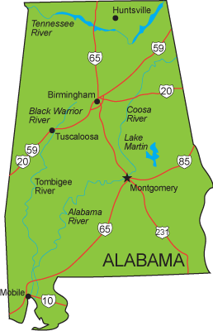
Alabama Exports
International trade, including exports and imports, supports 567,500 Alabama jobs
Alabama exported $20.6 billion worth of goods in 2016
  Small and medium sized businesses accounted for 81% of Alabama exporters
Free trade agreement markets accounted for 41% of Alabama exports
Alabama’s top export markets are Canada, China, Germany, and Mexico
According to the U.S. International Trade Administration and Business Roundtable

Slide 7
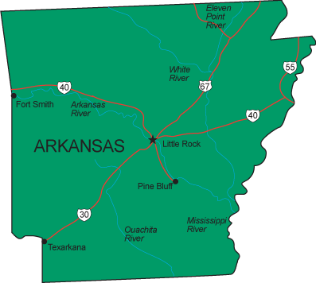
Arkansas Exports
International trade, including imports and exports, supports 348,000 Arkansas jobs
Arkansas exported $5.7 billion in goods in 2016
  Of Arkansas’ exporters, 80% are small- and medium- sized businesses
Free trade agreements (FTAs) have helped fuel rapid export growth from Arkansas to partner companies
  In 2016, 45% of Arkansas’ goods exports went to FTA partners
Arkansas’ top export markets are Canada, France, and Mexico.
According to the U.S. International Trade Administration and Business Roundtable

Slide 8
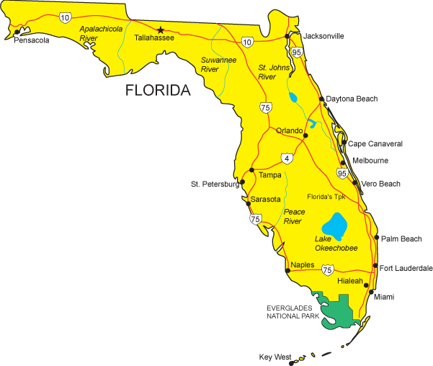
Florida Exports
International trade, including exports and imports, supports 2,505,500 Florida jobs
Florida exported $52 billion worth of goods exports in 2016
  Small and medium sized business account for 95% of Florida goods exporters
Free trade agreement markets accounted for 40% of Florida exports
Florida’s top export markets are Brazil, Canada, Mexico, Colombia, and Germany
According to the U.S. International Trade Administration and Business Roundtable

Slide 9
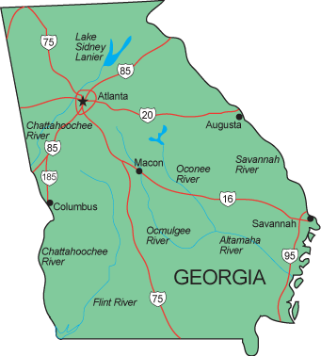
Georgia Exports
International trade, including exports and imports, supports 1,283,800 Georgia jobs
Georgia exported $35.7 billion worth of goods exports in 2016
  Small to medium sized business accounted for 89% of goods exporters in Georgia
Free trade agreement markets accounted for 42% of Georgia exports in 2016
Georgia’s top export markets are Canada, Mexico, and China
According to the U.S. International Trade Administration and Business Roundtable

Slide 10
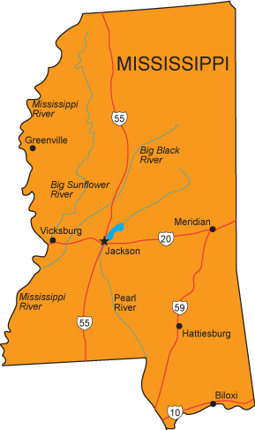
Mississippi Exports
International trade, including exports and imports, supports 339,500 Mississippi jobs
Mississippi exported $10.5 billion worth of goods exports in 2016
  Small and medium sized businesses accounted for 77% of exporters in Mississippi in 2014
Free trade agreement markets accounted for 58% of Mississippi exports
  Since 2006, exports from Mississippi FTA markets have grown by 159%
Mississippi’s top export markets are Canada, Mexico, and Panama
According to the U.S. International Trade Administration and Business Roundtable

Slide 11
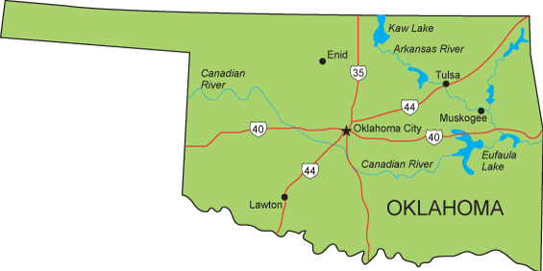
Oklahoma Exports
International trade, including exports and imports, supports 401,000 Oklahoma jobs
Oklahoma exported $5 billion worth of goods exports in 2016
  Small and medium sized businesses accounted for 85% of Oklahoma exporters
Free trade agreement markets accounted for 51% of Oklahoma exports in 2016
Oklahoma’s top export markets are Canada, Mexico, and Germany
According to the U.S. International Trade Administration and Business Roundtable

Slide 12
Puerto Rico Exports
Puerto Rico’s exports were valued at almost $16 billion in 2017
Its main exports are chemicals, electronics, apparel, fish, rum, beverage concentrates, and medical equipment
The U.S. is the main trading partner of Puerto Rico and accounts for 90% of Puerto Rico’s exports and over 55% of its imports
Puerto Rico also exports to the Netherlands, the Dominican Republic, and the UK

Slide 13
Key Issues of NADEC
NADEC is currently focused on four key issues:
Threat of North American Free Trade Agreement (NAFTA) Withdrawal
Export-Import Bank Fully Operational
Recent Tariffs & Senate Action on the Miscellaneous Tariff Bill (MTB) Legislation
Reduction of Adequate Funding for the U.S. Commercial Service

Slide 14
Threat of NAFTA Withdrawal
The North American Free Trade Agreement was signed into law in 1993, opening trade between the United States, Canada, and Mexico
Canada and Mexico are the largest importers of U.S. products, buying one-fifth of all US manufactured goods and supporting 2 million U.S. jobs
NAFTA is currently under renegotiation, and there have been threats of complete withdrawal
There have been 9 rounds of negotiations with little progress

Slide 15
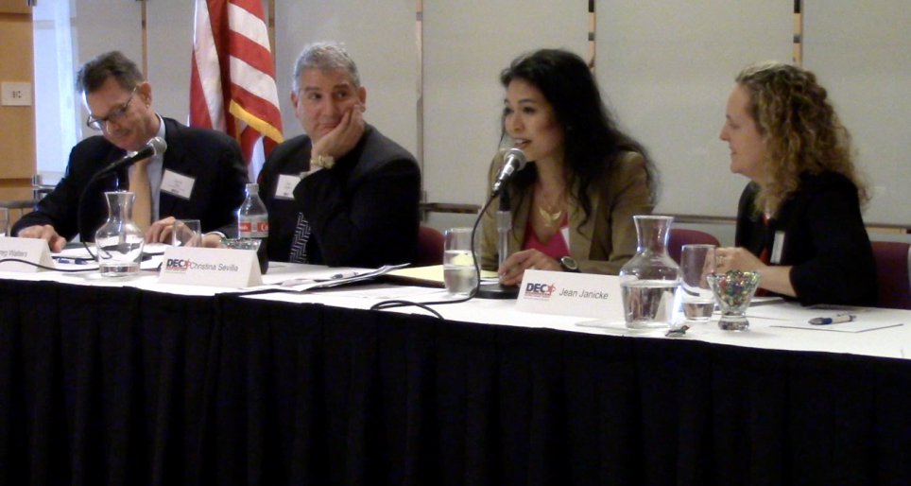
Threat of NAFTA Withdrawal
Major sticking points between the U.S. and Canada/Mexico:
  Dispute Settlement- U.S. demands option to opt out of dispute resolution panels
  Sunset Clause- U.S. demands a review of trade deal every 5 years
  Automotive rules of origin- U.S. demands 75% of parts be made in North America, 40% of components built by workers making at least $16 per hour
DEC supports the modernization of NAFTA, as well as other FTAs, and asks DEC members to advocate for these
David Day, member of NADEC, Dr. Christina Sevilla, Deputy Assistant U.S. Trade Representative, and representatives from the Commerce Dept. discuss FTAs, including NAFTA and KORUS

Slide 16
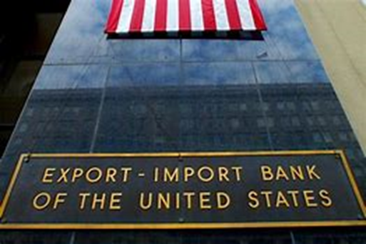
Export-Import Bank
The Ex-Im bank was created to help American companies compete overseas and bolster exports by providing affordable government-backed loan guarantees
The Ex-Im Bank was last fully operational in 2014 and is lacking positions of leadership
The absence of leadership at the bank has put American companies at a global disadvantage
Kimberly Reed was nominated on June 20, 2018 as President and Chairwoman of the Bank and has support from the business community for confirmation by the Senate

Slide 17
Tariffs on Steel & Aluminum
On June 1st, 2018, a 25% tariff on imported steel and a 10% tariff on imported aluminum took effect
About a third of the steel used by American businesses are imports; more than 60% of the overall market for aluminum supply comes from imports
The tariffs will make ordinary items produced with aluminum more expensive – like baseball bats and beer cans
Many of the US’s trading partners and allies have threatened retaliatory tariffs on US exports

Slide 18
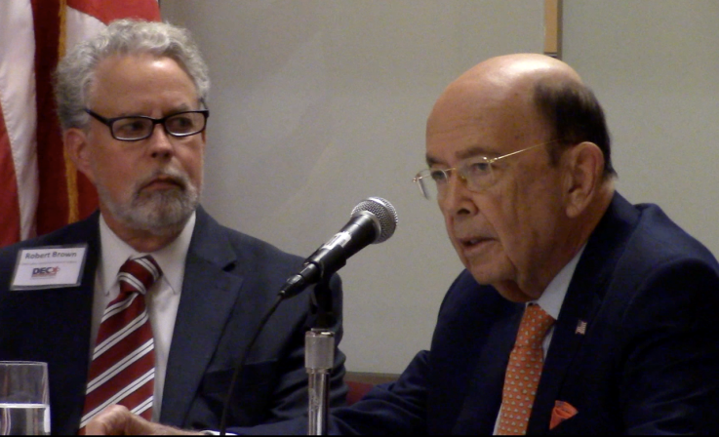
Tariffs on Chinese Goods
President Trump released a statement claiming that trade between the U.S. and China has been unfair, due to China’s practices in the acquisition of American intellectual property
A 25% tariff on $50 billion of Chinese goods
Additional tariffs of $100 billion if China pursues retaliatory tariffs
The first of the tariffs will take place on July 6 summing $34 billion, and the second, summing $16 billion, will take place after a public notice and comment process
Commerce Secretary Wilbur Ross and NADEC Chair Robert Brown discuss Chinese influence

Slide 19
Impact of New Tariffs on Alabama
Because of the new tariffs on steel, aluminum, and Chinese imports, China, the EU, Mexico, and Canada have retaliated or announced plans to retaliate with billions of dollars in tariffs on American-made products
Retaliatory measures threaten $3.6 billion of Alabama exports
Alabama’s hardest hit products are aluminum alloy, alloy steel, stainless steel, and passenger vehicles
An emerging trade war endangers the 567,500 Alabama jobs supported by global trade
According to the U.S. Chamber of Commerce

Slide 20
Impact of New Tariffs on Arkansas
Because of the new tariffs on steel, aluminum, and Chinese imports, China, the EU, Mexico, and Canada have retaliated or announced plans to retaliate against the new U.S. tariffs with billions of dollars in tariffs on American-made products
Retaliatory measures threaten $339 million of Arkansas exports
Arkansas’ hardest hit products are paper and paperboard, cotton, types of frozen vegetables, and types of iron/non-alloy steel
An emerging trade war endangers the 348,400 Arkansas jobs supported by global trade
According to the U.S. Chamber of Commerce

Slide 21
Impact of New Tariffs on Florida
Because of the new tariffs on steel, aluminum, and Chinese imports, China, the EU, Mexico, and Canada have retaliated or announced plans to retaliate against the new U.S. tariffs with billions of dollars in tariffs on American-made products
Retaliatory measures threaten $713 million of Florida exports
Florida’s hardest hit products are motorboats and aluminum waste and scrap
An emerging trade war endangers the 2,502,500 Florida jobs supported by global trade
According to the U.S. Chamber of Commerce

Slide 22
Impact of New Tariffs on Georgia
Because of the new tariffs on steel, aluminum, and Chinese imports, China, the EU, Mexico, and Canada have retaliated or announced plans to retaliate against the new U.S. tariffs with billions of dollars in tariffs on American-made products
Retaliatory measures threaten $750 million of Georgia exports
Georgia’s hardest hit products are lawn mowers, metal furniture, aluminum waste and scrap, and yachts, row boats, and canoes
An emerging trade war endangers the 1,283,800 Georgia jobs supported by global trade
According to the U.S. Chamber of Commerce

Slide 23
Impact of New Tariffs on Mississippi
Because of the new tariffs on steel, aluminum, and Chinese imports, China, the EU, Mexico, and Canada have retaliated or announced plans to retaliate against the new U.S. tariffs with billions of dollars in tariffs on American-made products
Retaliatory measures threaten $519 million of Mississippi exports
Mississippi’s hardest hit products are aluminum casks and cans, flat-hot-rolled iron, non-alloy steel coil, soybeans, and articles of iron or steel
An emerging trade war endangers the 339,500 Mississippi jobs supported by global trade
According to the U.S. Chamber of Commerce

Slide 24
Impact of New Tariffs on Oklahoma
Because of the new tariffs on steel, aluminum, and Chinese imports, China, the EU, Mexico, and Canada have retaliated or announced plans to retaliate against the new U.S. tariffs with billions of dollars in tariffs on American-made products
Retaliatory measures threaten $208 million of Oklahoma exports
Oklahoma’s hardest hit products are iron or non-alloy steel pipe, frozen swine meat, fresh or chilled meat, and articles of iron or steel
An emerging trade war endangers the 401,000 Oklahoma jobs supported by global trade
According to the U.S. Chamber of Commerce

Slide 25
Miscellaneous Tariff Bill
A Miscellaneous Tariff Bill (MTB) is a law that temporarily reduces or suspends the import tariffs paid on particular products imported into the United States
The last MTB passed by Congress expired on December 31, 2012. Since then, businesses have paid billions of dollars of tariffs on products needed for domestic manufacturing
MTB of 2018 would eliminate import tariffs of more than $1.1 billion over the next three years and boost U.S. manufacturing output by more than $3.1 billion
The MTB of 2018 was passed by the House on January 16, 2018, but the Senate has yet to take action

Slide 26
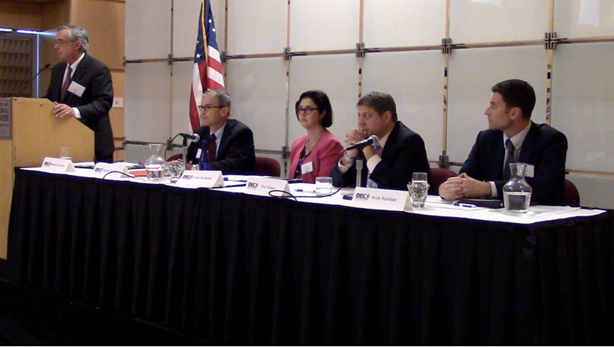
The U.S. Commercial Service
The Commercial Service had and continues to have a growing number of vacancies in the US and overseas fields
The organization helps small-to-medium sized companies expand exports overseas
In the funding for fiscal year 2019, the Administration has asked for cuts to the Commercial Service of $44.5 million from their previous $320 million budget
The Senate and the House have completed reports protecting the Commercial Service for FY19, giving funding of $319 million
Funding needs to be increased by $50 million, in order to restore staffing in the US field and expand to posts overseas
A panel led by NADEC member Bill Cummins, discussing Commerce funding. Dan Crocker with the Dept. of Commerce and Linda Dempsey with NAM are advocating for increased funding and the filling of open Commercial Officer positions.

Slide 27
Get Involved!
Educate your community on the importance of trade
Mentor small businesses in developing export markets
Contact your local, state, or national representatives about key NADEC issues
For more information on how to get involved, or to contact NADEC, visit www.districtexportcouncil.org.

Slide 28
Contact Your DEC
Alabama District Export Council
Michael Lee, Chair
  mlee@pagejones.com
Robert Stackpole, Executive Secretary
  robert.stackpole@trade.gov
NADEC Regional Legislative Network
Region 2, Southeast
Anne Burkett, Director of Planning & Economic Development, Madison County Commission and NAITA Executive Director
  (256) 532-3505
  aburkett@madisoncountyal.gov

Slide 29
Contact Your DEC
Arkansas District Export Council
Lenka Horakova, Chair
lenka.horakova@lhglobalsolutions.com
James Aardappel, Executive Secretary
james.aardappel@trade.gov

Slide 30
Contact Your DEC
Northern and Central - West Florida District Export Council
Dr. Ozkan Erdem, Chair
  oerdem@districtexportcouncil.org
Kenneth Mouradian, Executive Secretary
  kenneth.mouradian@trade.gov
South Florida District Export Council
Jim Anzalone, Chair
  Jim@WeAreCompliant.com
Eduardo Torres, Executive Secretary
  eduardo.torres@trade.gov

Slide 31
Contact Your DEC
Georgia District Export Council
Maureen Halstead, Chair
  Maureen.Halstead@kaminllc.com
George Tracy, Executive Secretary
  George.Tracy@trade.gov

Slide 32
Contact Your DEC
Mississippi District Export Council
Craig Harvey, Chair
  charvey@nvisionsolutions.com
Carol Moore, Executive Secretary
  carol.moore@trade.gov

Slide 33
Contact Your DEC
Oklahoma District Export Council
Charles Mills, Chair
  chuck@millsmachine.com
Marcus Verner, Executive Secretary
  marcus.verner@trade.gov

Slide 34
Contact Your DEC
Puerto Rico District Export Council
Edmundo Rodriguez, Chair
  e.rodriguez@nreyes.com
Jose F. Burgos, Executive Secretary
  jose.burgos@trade.gov

